Slide 1


Kohinoor Chemicals Co. (Bd) Ltd.
Arnab Kumar Debnath(1808011)
Afshana Mimi Jhinuk (1808013)
Mostafizur Rahman Khan(1808018)
Rumeen Chowdhury(1808020)
Anika Tahsin(1808031)
Md. Tanvir Ahmmed Fahim(1808041)
IPE 300
Industrial Practice
1

Slide 2
Overview
01
Products and Departments
02
Noteworthy Challenges
03
Solution Project 1
04
Solution Project 2
2

Slide 3
Product Categories
Soaps
Home Care
Toilet & Laundry Soap
Grooming Products
Cosmetics
Detergents
  Skin & Hair Care
Perfumery
3

Slide 4
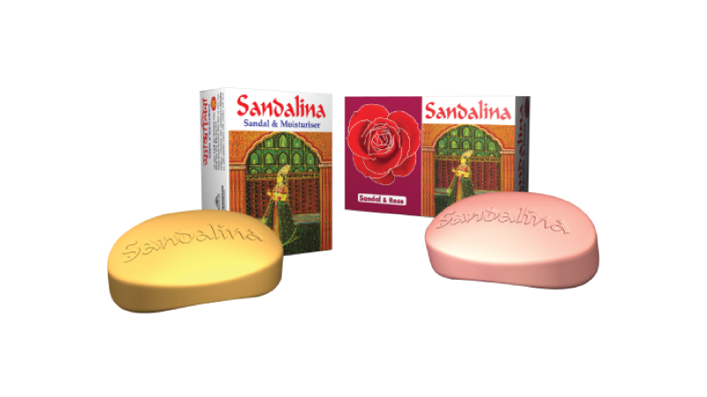





Soaps

Slide 5


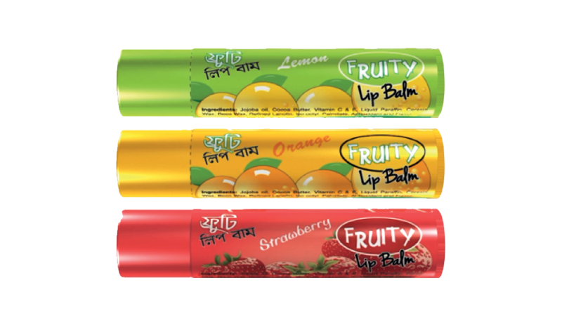



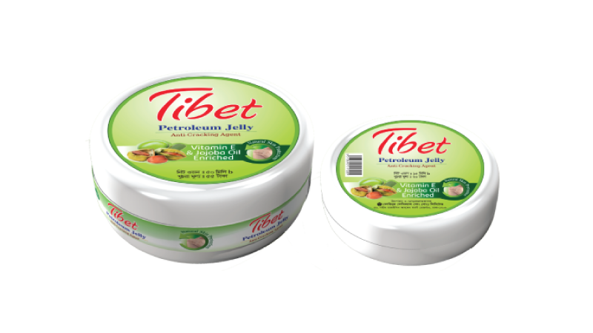






Cosmetics
5

Slide 6




Home Care
Perfumery

Slide 7





Grooming Products
Detergents
7

Slide 8




Departments
8

Slide 9
Panshed
Raw Materials
(Fats/Oils, NaOH, NaCl)
Neat Soap
9

Slide 10
Chemical Processes
Saponification
1st Neutral Wash
2nd Neutral Wash
Saponification
3rd Neutral Wash
Powder Wash
Powder Wash
Fitting
Fitting
For Toilet Soap
For Laundry Soap

Slide 11
Floor Layout
Glycerin Store
Soap Store
Caustic Soda Store
Soap Noodle

Slide 12
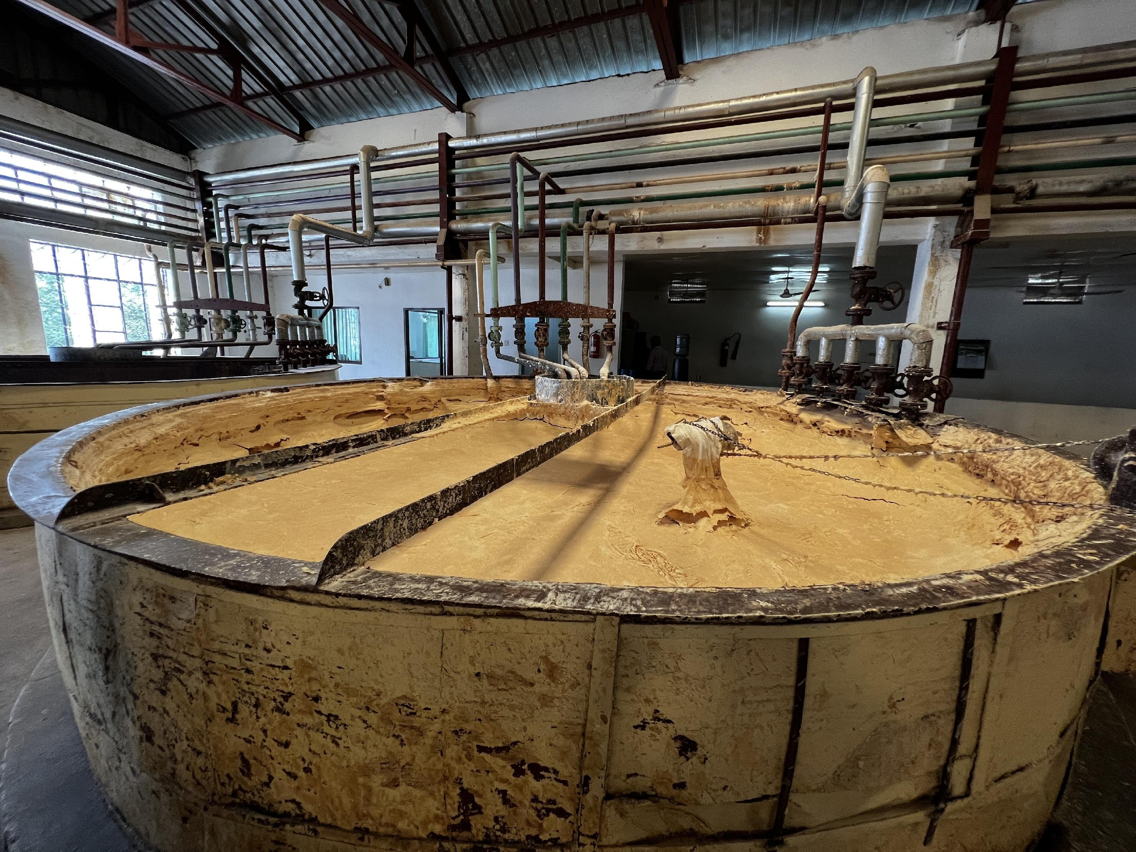
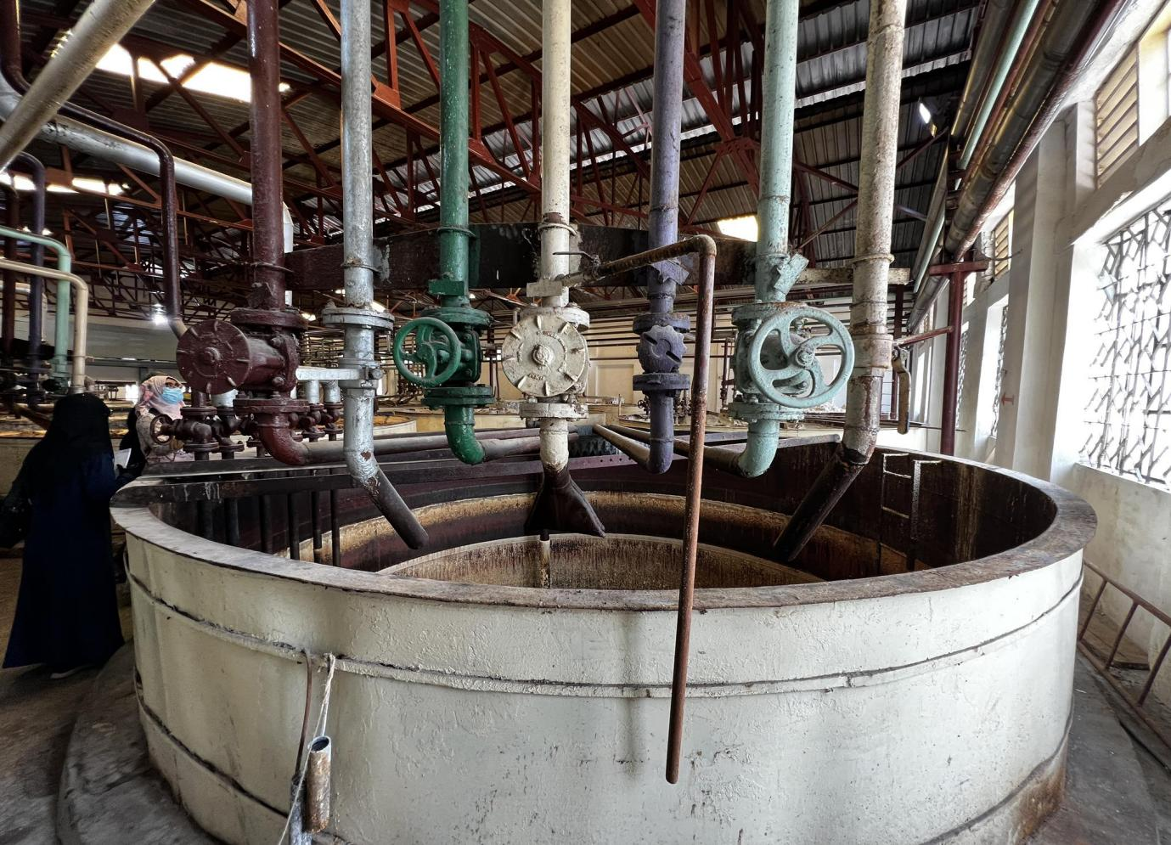
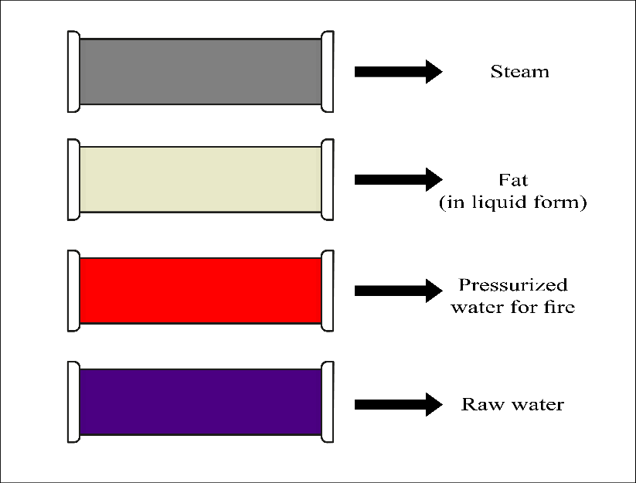
Pan
Color Coded Pipelines
12

Slide 13
Soap Section
+ Color
Neat Soap
Processing
Finished Product
+ Perfume
13

Slide 14
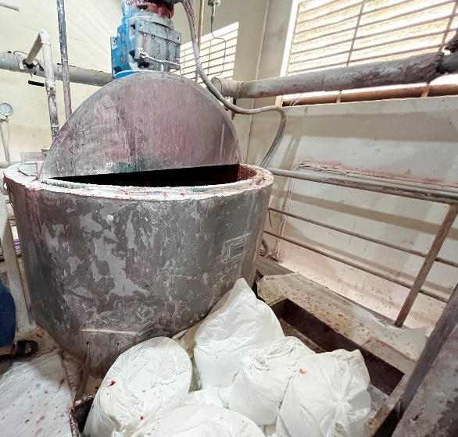
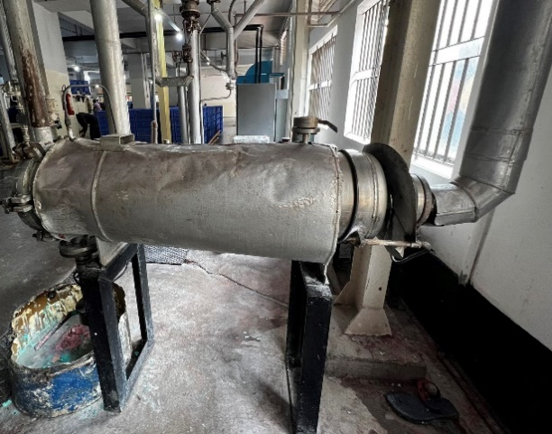
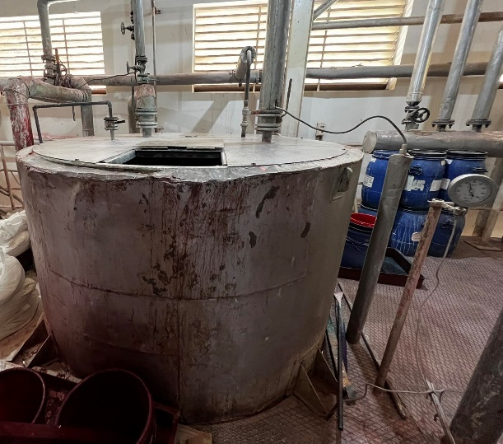
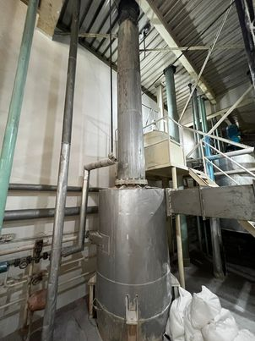
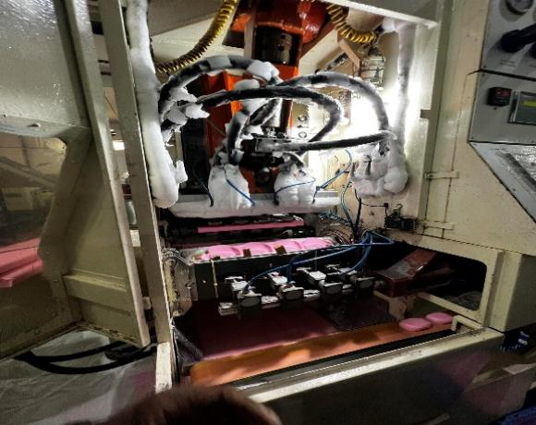
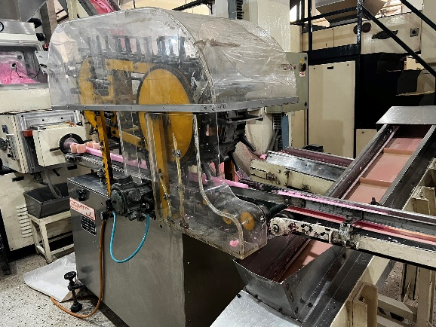
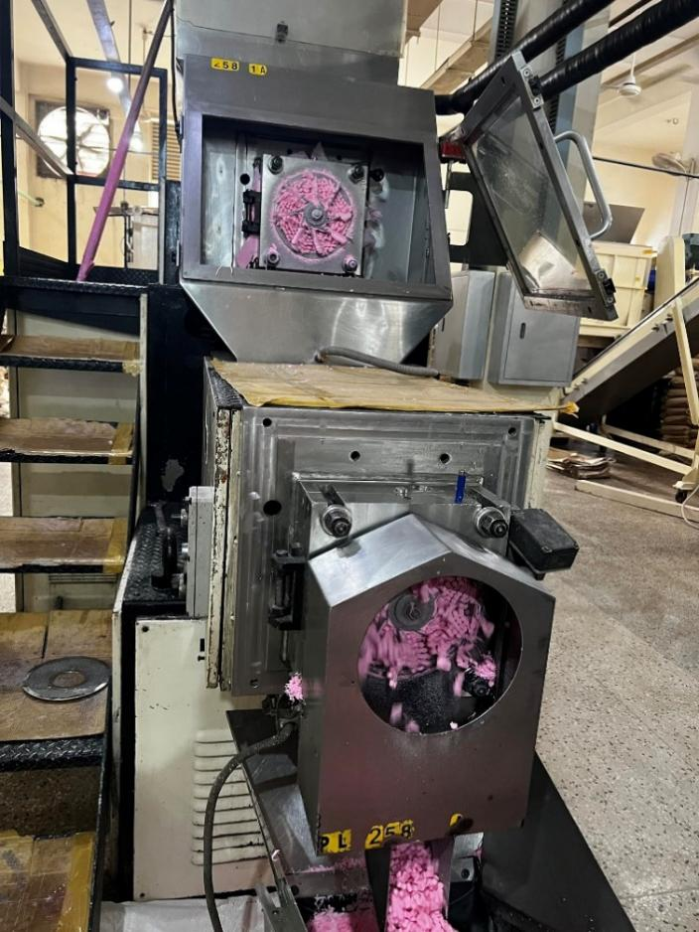
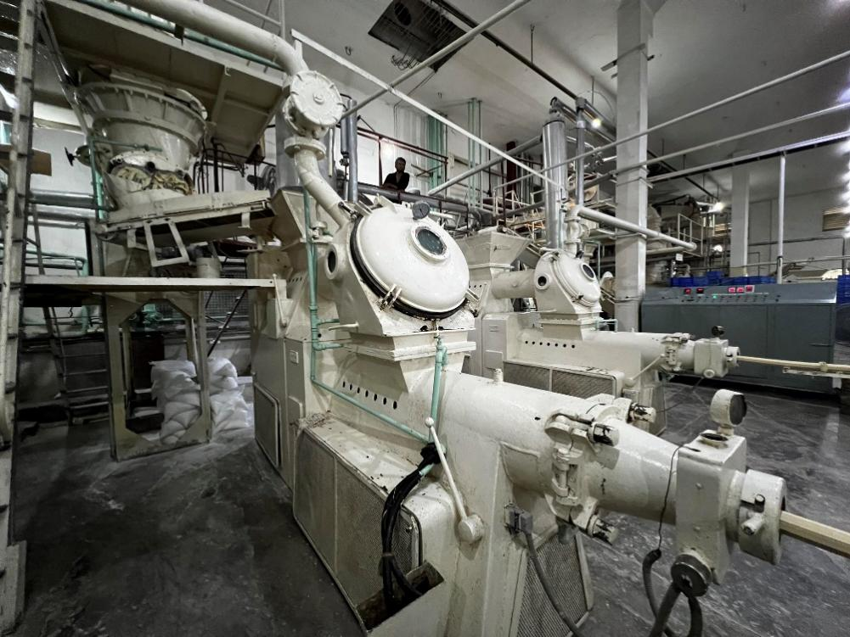
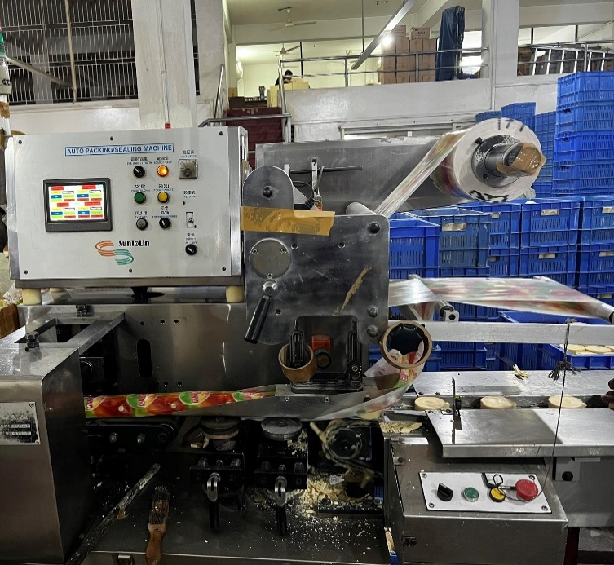
Crutcher
Filter
Feed Tank
Heat Exchanger
Stamper
Cutter
Plodder
Atomizer
Packaging

Slide 15
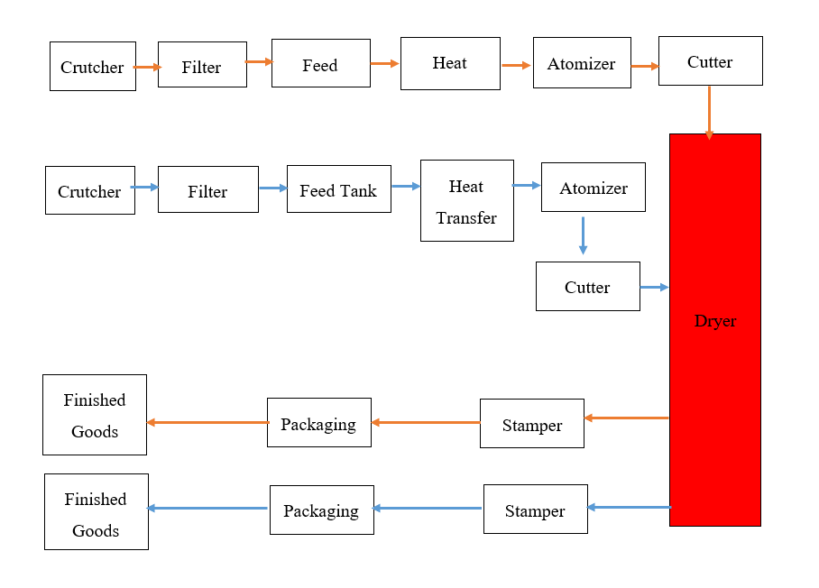
Flow Charts for different Plants
Plant 1,2 & 4

Slide 16
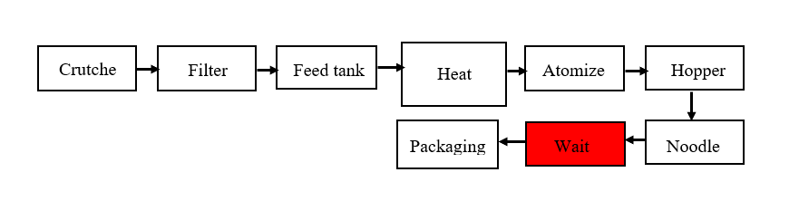
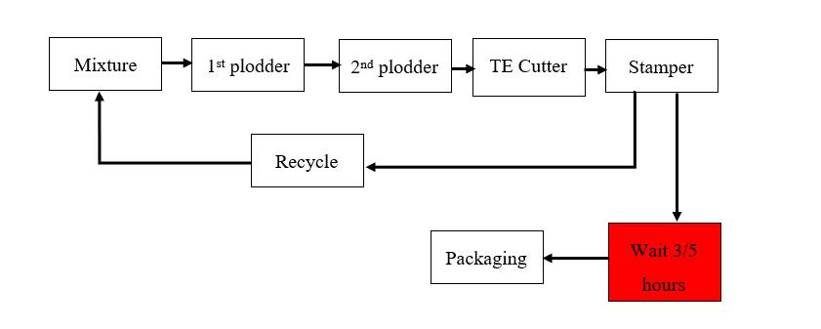
Plant 6
Plant 7,8 & 9

Slide 17
Cosmetics Section
Raw Materials
Finished Product
17

Slide 18
Production
Processes
Mixing
Mixing
Filling
Filling
Capping
Labelling of Glass Container
Capping
Sealing
Shrink Wrapping Machine
Shrink Wrapping of Seals
Checking
Individual Boxing
Boxing
Shrink Wrapping of a pack of 6 Boxes
Taping
Packing in Cartoons
For Powder
For Tibet Snow

Slide 19
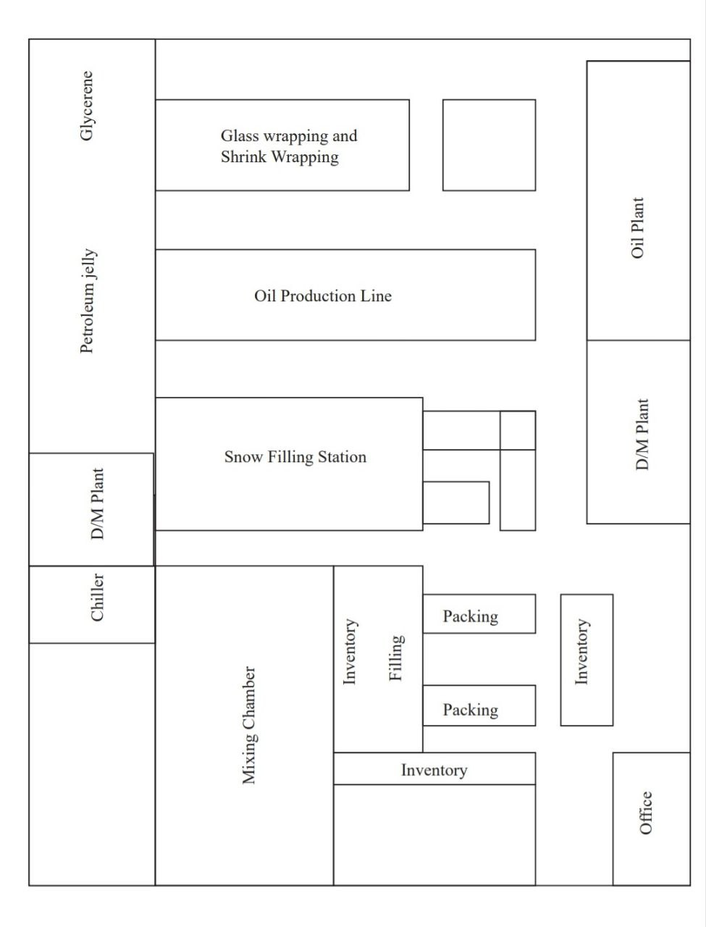
Ground Floor

Slide 20
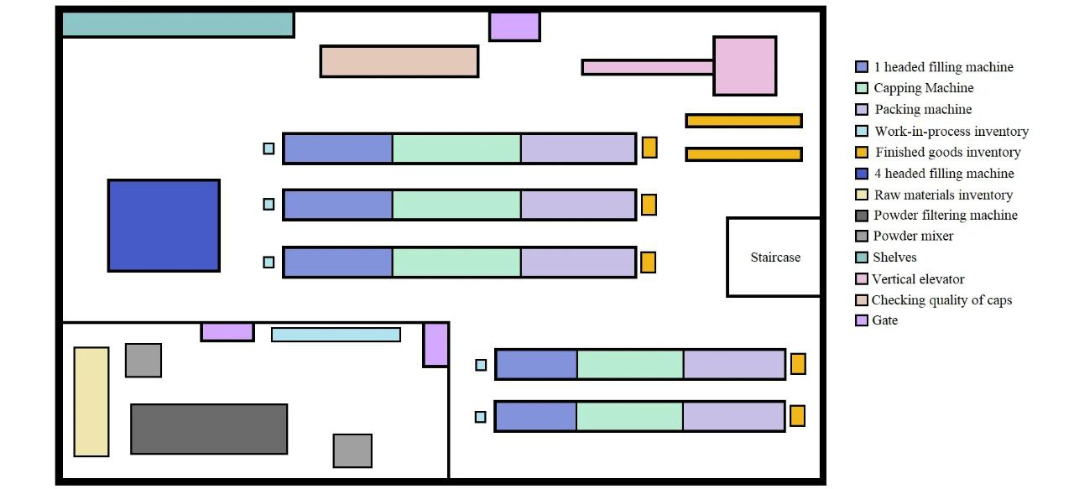
First Floor

Slide 21
Quality Control Department

Slide 22
Sub-Departments Under the QC Department
Quality Control
Quality Assurance
R&D

Slide 23

Functions of the QC Sub-department
Quality Testing of Final Products
Quality Testing of Raw Materials
QC
Department
Acceptance Sampling
Quality Assurance

Slide 24
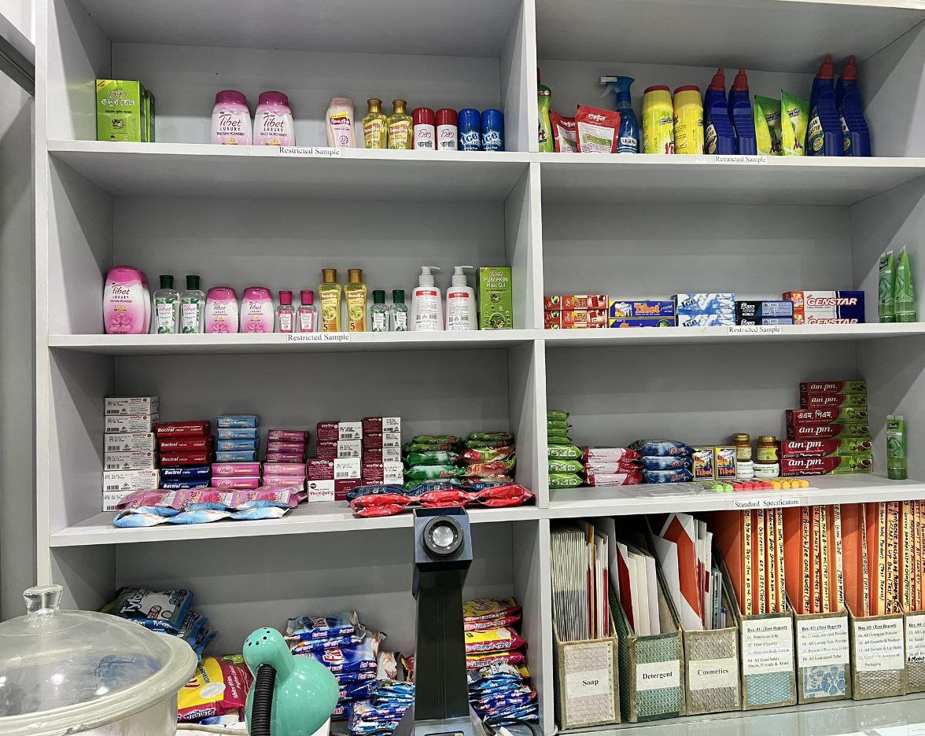
Functions of the QA Sub-department
Monitoring the production.
Fixing potential quality problems in the production phase

Slide 25
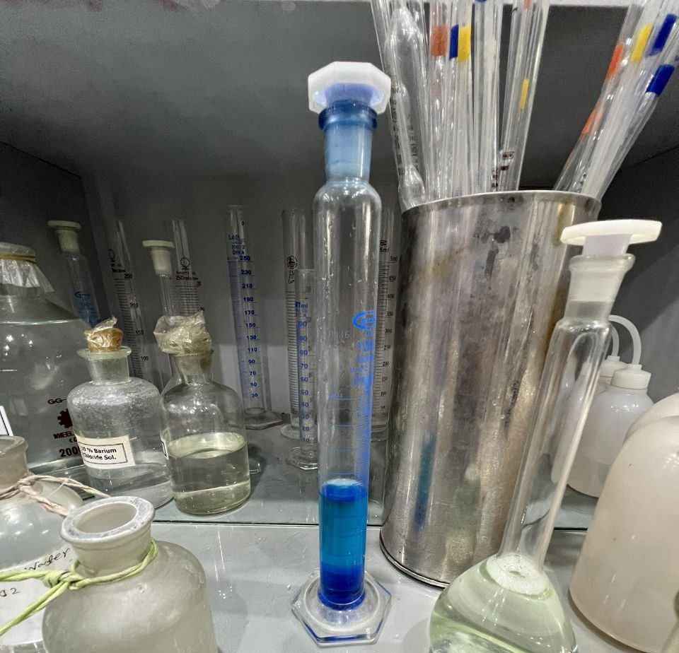
Functions of the R&D Sub-department
Benchmarking
Existing products from other brands as motivation
Innovation
Innovative Formulation

Slide 26
PROJECTS

Slide 27

01
Inventory Space Utilization

Slide 28
Table of contents
01
Problem
04
Cost Analysis
02
Solution
05
Benefits
Analysis
03
Methodology

Slide 29
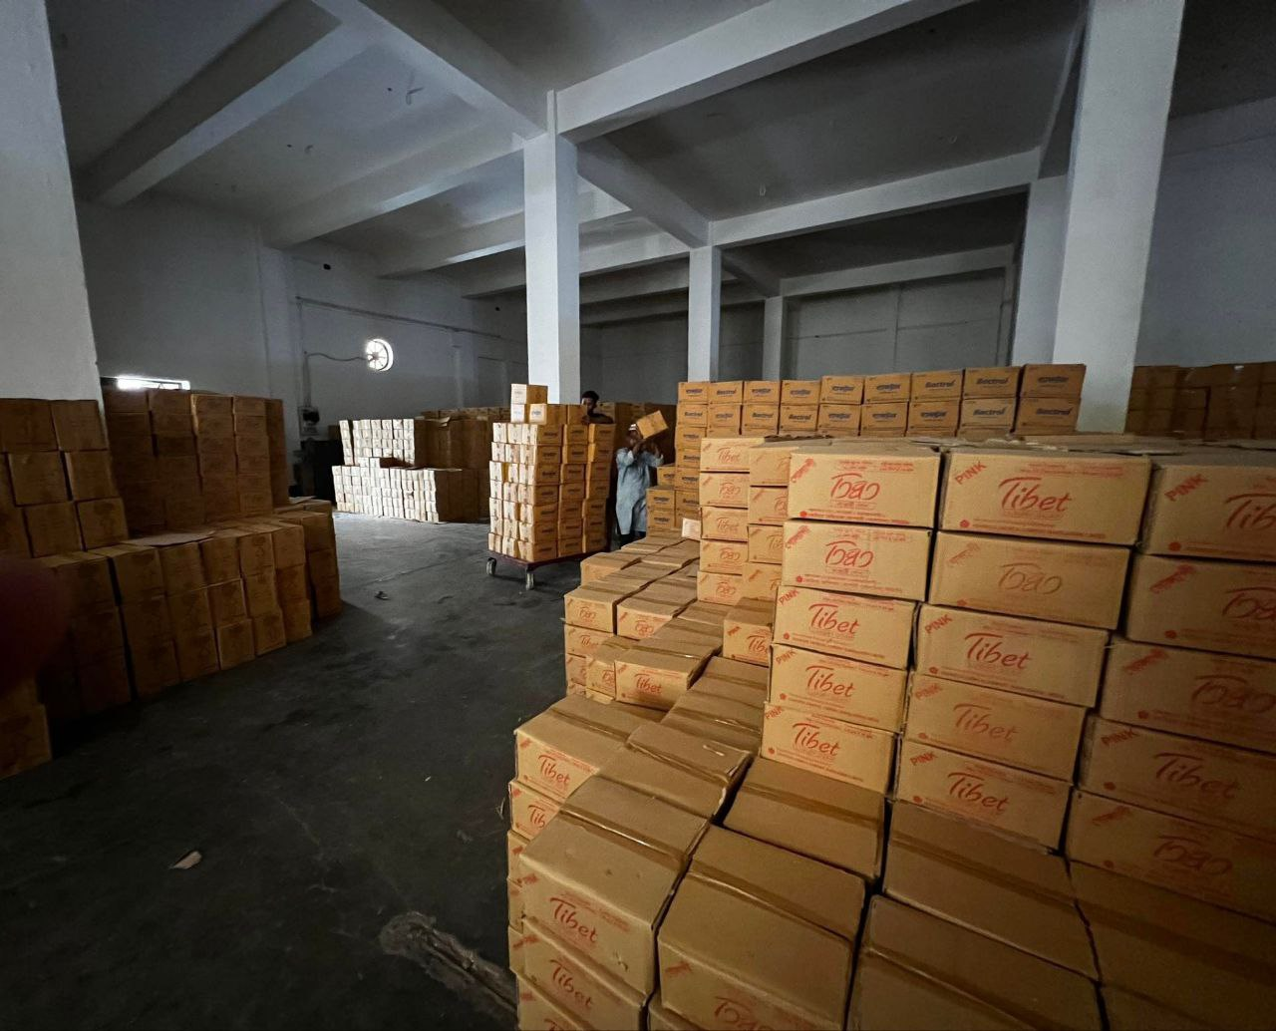
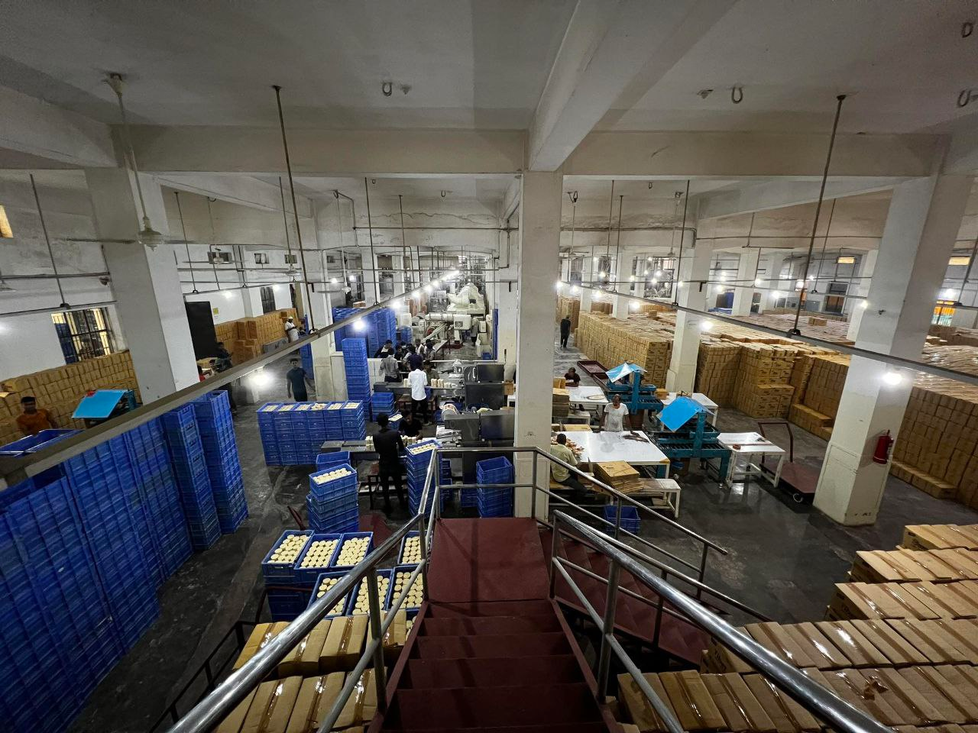
Observations
Underutilization of vertical space
Excessive Material Handling Required
Frequent Machine Breakdown

Slide 30
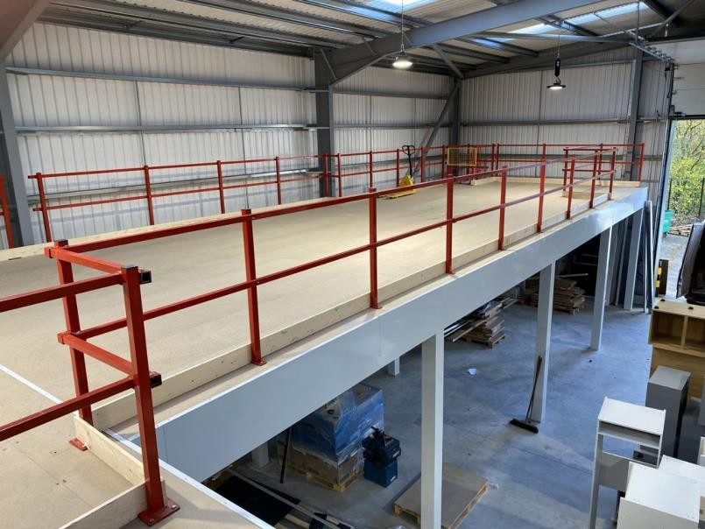
Solution!
Mezzanine Floor

Slide 31
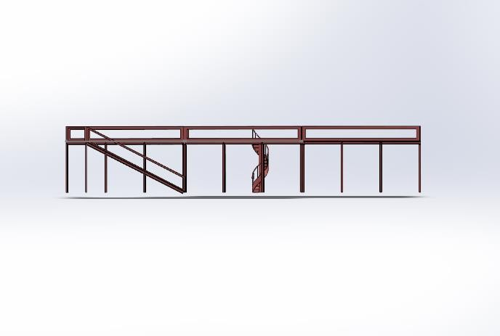
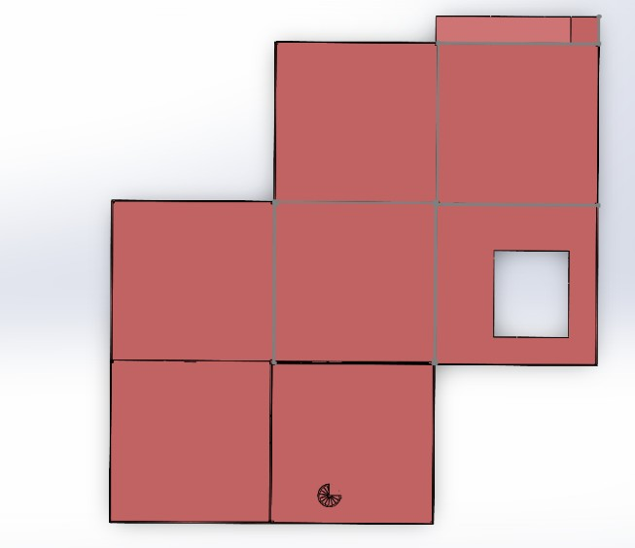
Solution!
Front View
Top View

Slide 32
Methodology
01
02
03
04
05
Idea Screening
CAD Model Designing
Development scope identification and Concept generation
Feasibility Analysis
Cost Benefit Analysis

Slide 33
Structural Elements Overview
Element | Material | Specifications
I-beam | Mild steel | 5”x 10”x 8mm
I-joist | Mild steel | 5”x 10”x 8mm
U-channel | Mild steel | 4”x 2”x 5mm
MS checker plate | Mild steel | 5mm thick

Slide 34
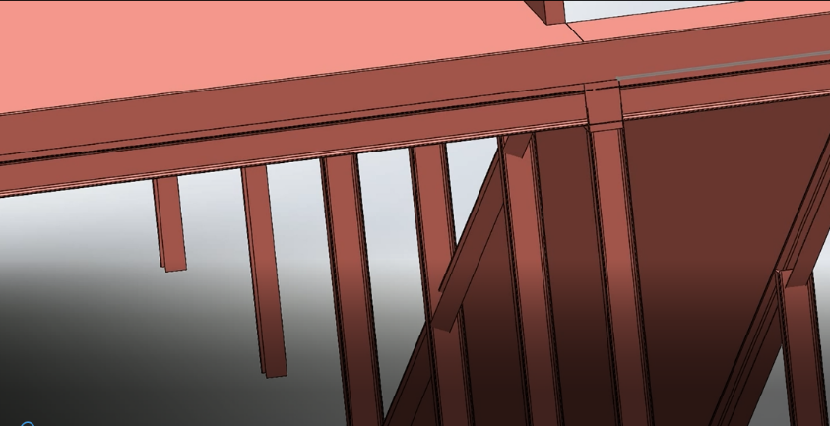
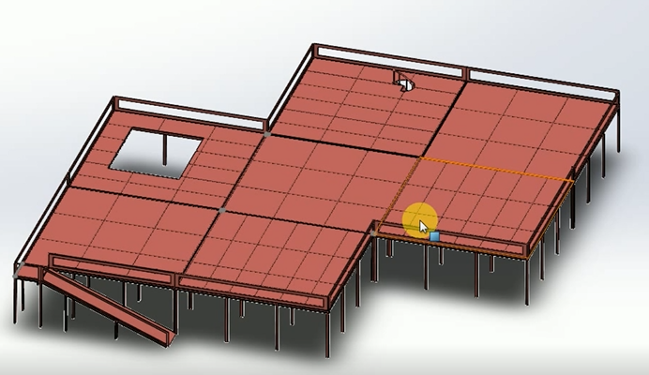
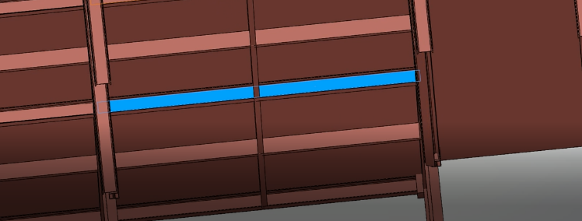
Structural Elements: Key Uses
I-Beam
I-Joist
MS checker plate
U-Channel

Slide 35
Part Functionality
Proposed Mezzanine Floor Parts:
1. Inclined Steel Pathway: Uses gravity for box unloading, eliminating the need for external power.
2. Vertical Elevator: Utilizes an existing one-way elevator to transfer packages between floors.
3. Spiral Stair: Provides compact access for workers, maximizing storage space.
35

Slide 36
Cost Analysis of Mezzanine Floor
Sl No. | Description | Unit | Quantity | Rate (Tk.) | Amount (Tk)
1 | Main Members (Column, Beam, Rafter, Base Plate, Joint Plate, End Plate, Connection Plate, Purlin Cleat, Strut Member) etc. (40 Ksi Steel) | kg | 27223.00 | 143.00 | 3892889.00
2 | Decking Panel (0.70mm) | kg | 4846.00 | 145.00 | 702670.00
3 | Share Bolt | kg | 636.00 | 180.00 | 114480.00
4 | Edge Capping (0.70mm) | R.ft | 197.00 | 95.00 | 18715.00
5 | Chemical Bolt | Pcs | 134.00 | 400.00 | 53600.00
6 | Nut Bolt | kg | 333.00 | 210.00 | 69930.00
7 | Erection Charge | kg | 32401.00 | 8.00 | 259208.00
8 | Paint (2 Coat) | kg | 32401.00 | 6.00 | 194406.00
9 | Stair | kg | 520.00 | 150.00 | 78000.00
10 | Transportation | LS | 32401.00 | 2.00 | 64802.00
[For 5854 sqft] Total Amount (Tk) = |  |  |  |  | 5448700.00

Slide 37
Benefits of Mezzanine Floor
Optimal Resource Utilization
Increased machine efficiency due to better ventilation
Economical (compared to purchasing a warehouse)
Minimum disruption to business/daily tasks
Easy to assemble/disassemble

Slide 38
MEZZANINE FLOOR
COMPARISON CHART
MEZZANINE FLOOR
FEATURES
PRESENT
Ease of Material Handling
Space Utilization
Machine Efficiency
More Inventory Space

Slide 39
02
Statistical Quality Control with Excel and Power BI

Slide 40
Table of contents
01
Problem
04
Features
02
Motivation
05
Methodology
03
Solution

Slide 41
Observations
Scope of digitalizing data analysis process
Scope of implementing advanced SQC methods in the QC department.
No way to identify production inefficiency factors and solve them

Slide 42
Motivation
Knowledge of SQC and SQC tool.
SQC helps to understand process efficiency
Process efficiency is a must to achieve in a production process

Slide 43



Solution
Incorporation of Excel and Power BI
Excel: Creating form for data entry
Power BI: Analyzing with SCQ tools
SQC
Analysis Tool

Slide 44
Features
Easy Data Entry
Data entry has been made easy and efficient. 5 forms have been designed for this purpose. Each form is used for separate purposes. But entring data in them is easy and effortless. The user will need to extensive training to use them.
Automatic Outputs
After entering data, the user need not to worry about the analysis. All the outputs will be automatically updated. All they will need to do is to go to Power BI and they will find the analysis already done for them.
Automatic Updates
The updates are also automatic. After entering new data, the user does not have to go through some complicated steps to update the analysis according to the new data. All they will need to do is to click on a refresh button and the analysis will be updated.
Easy Filtering
The tool has an easy filtration process. The analysis can be filtered according to date and shift as needed. And for ease of use, sidebars and dropped down menus have been added in the report of the analysis so check for filtered analysis in an instant.

Slide 45
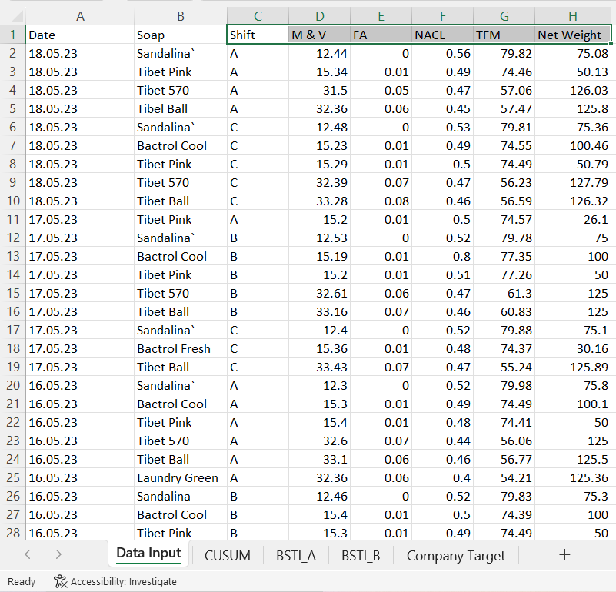
Features (Easy Data Entry)
Columns of “Daily Data Entry” Form:
Date: Date of experiment
Shift: Shift name of the material
M&V: Moisture and Volatile
FA: Fatty Acid
NACL: Salt concentration
TFM: Total Fatty Material
Net Weight: Total weight of the
soup

Slide 46
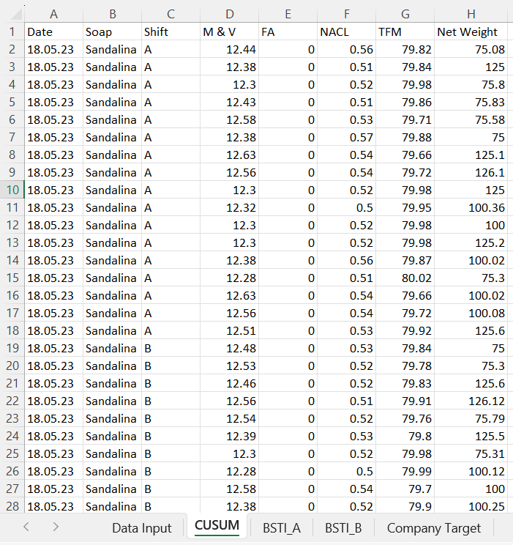
Features (Easy Data Entry)
Columns of “CUSUM” form:
Date: Date of experiment
Shift: Shift name of the material
M&V: Moisture and Volatile
FA: Fatty Acid
NACL: Salt concentration
TFM: Total Fatty Material
Net Weight: Total weight of the
soup

Slide 47
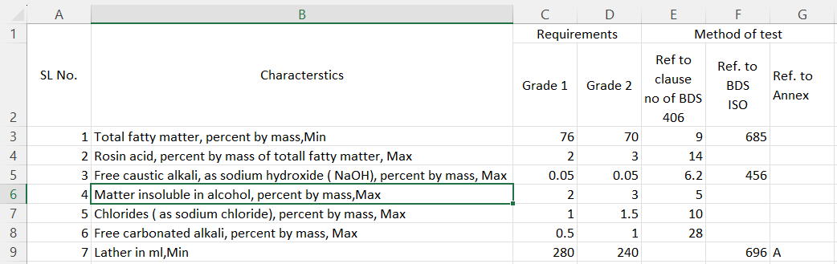
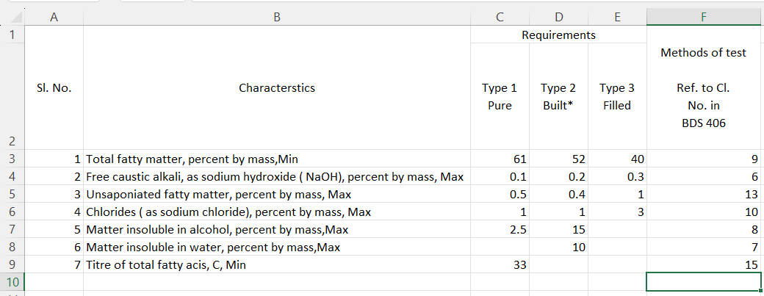
Features (Easy Data Entry)

Slide 48
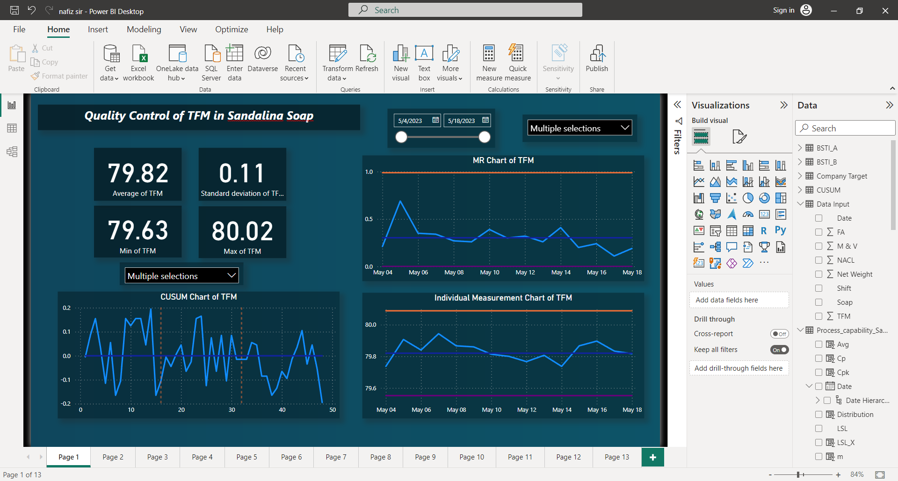
Features (Automatic Outputs)
Average value
Max, Min values
Standard Deviation
MR Chart
IM chart
CUSUM Chart

Slide 49
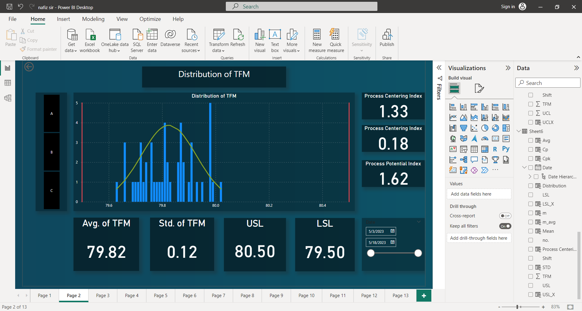
Features (Automatic Outputs)
Normal distribution curve
Average and standard deviation
Upper Specification Limit
Lower Specification Limit
Process Centering Indexes
Process Potential Index

Slide 50
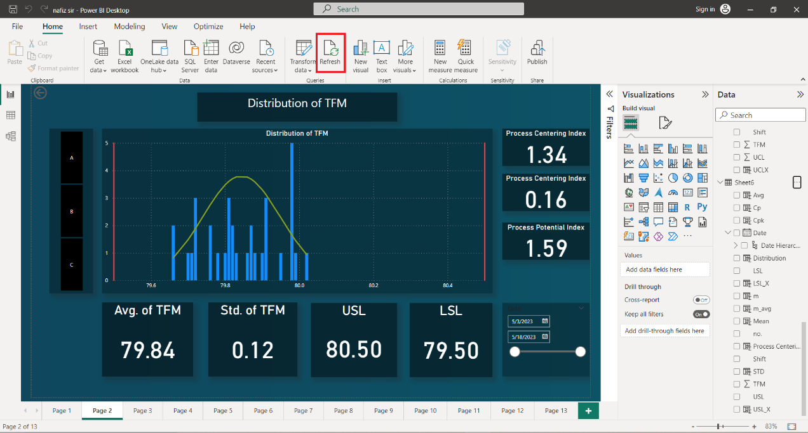
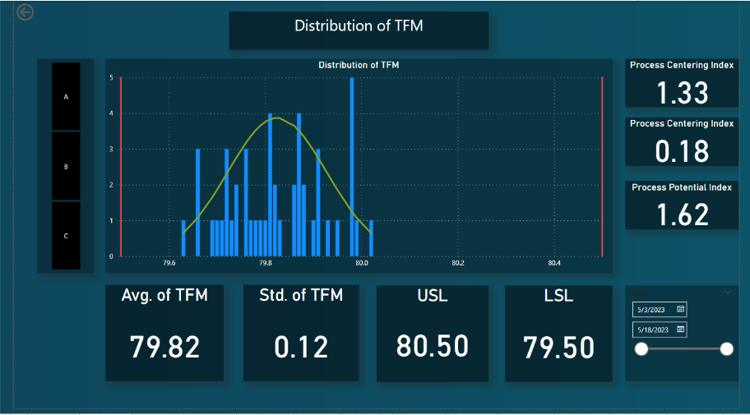
Features (Automatic Updates)
With a click in the Refresh button everything gets updated.

Slide 51
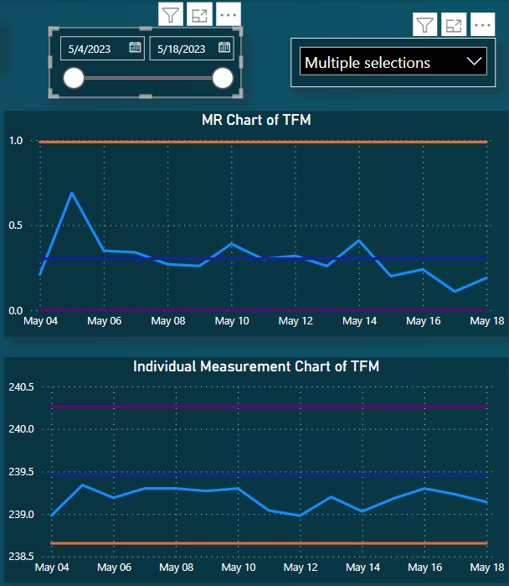
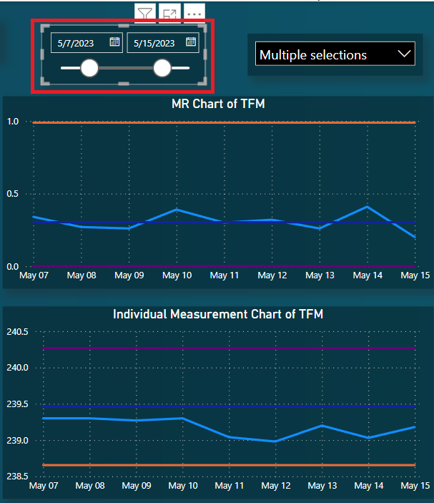
Features (Easy Filtering)
Filtration through date

Slide 52
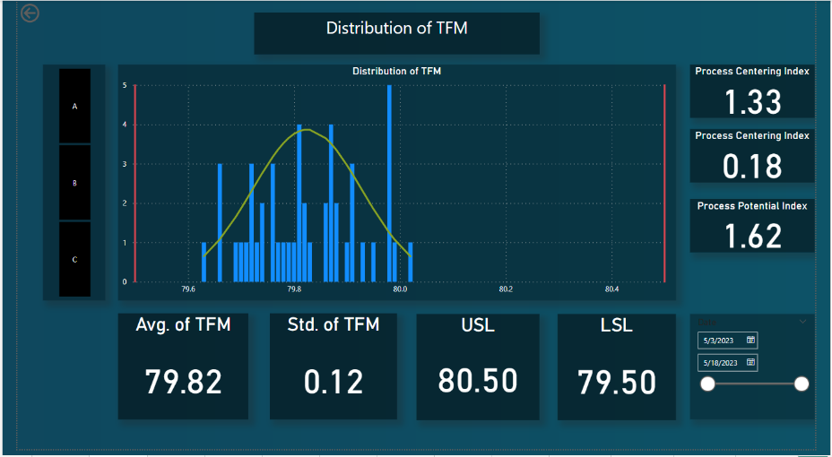
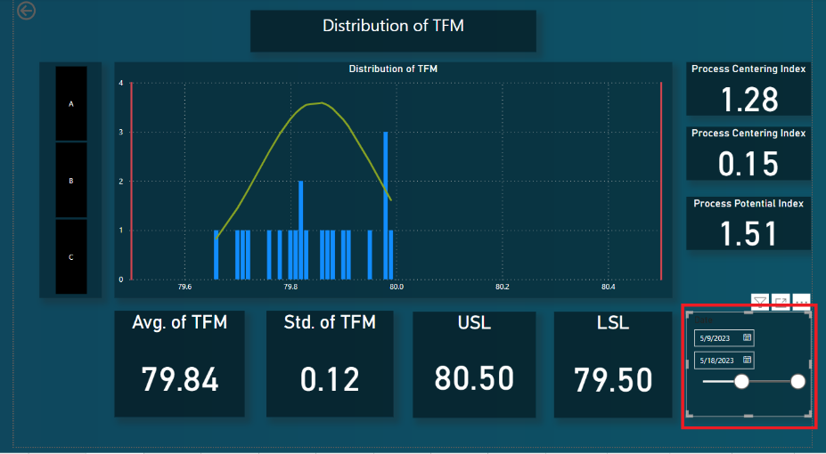
Features (Easy Filtering)
Filtration through date

Slide 53
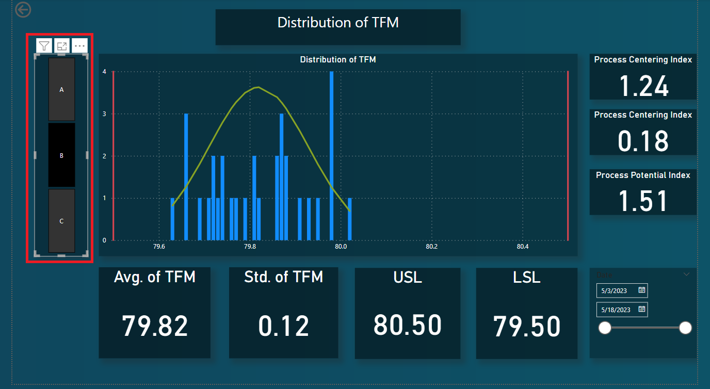
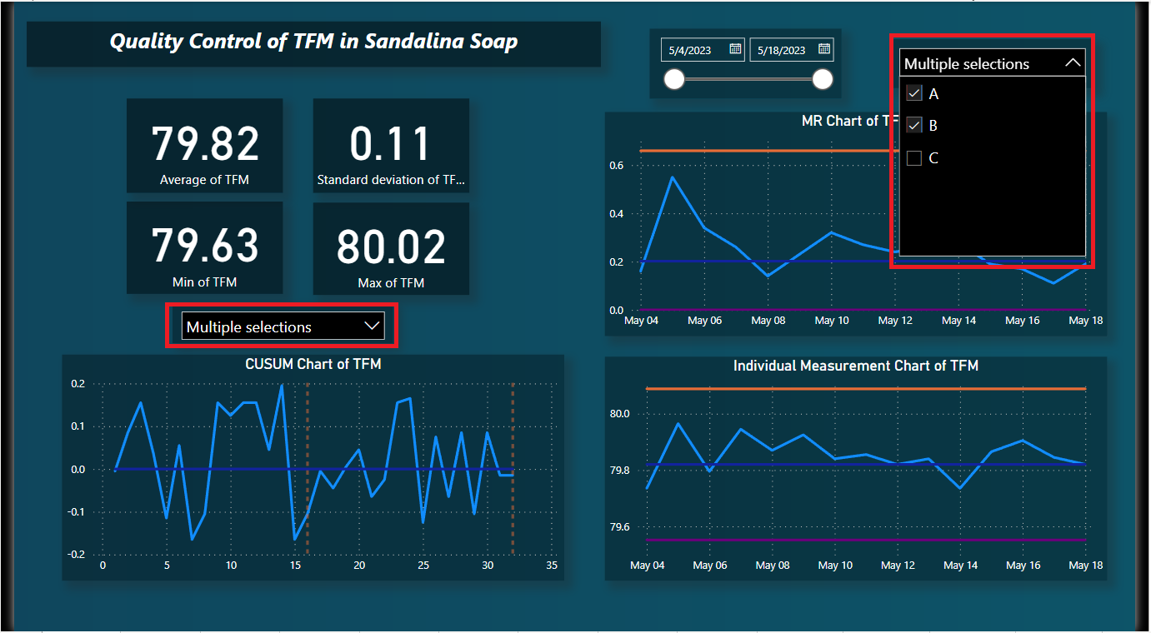
Features (Easy Filtering)
Filtration through shift

Slide 54
Methodology
Classifying Data according to soap
Classifying Data according to Feature
Soap Data
Quality Standards
CUSUM Data
CUSUM Data for one soap
Feature Data
Analysis Data

Slide 55
Methodology
Segregation of Data Entry form into Soap Data
Data Input
Sandalina
Bactrol Cool
Tibet Pink
Tibet 570
Laundry Green
Bactrol Fresh
Sandalina Rose
Tibet Blue
Tibet Ball
Laundry Blue

Slide 56
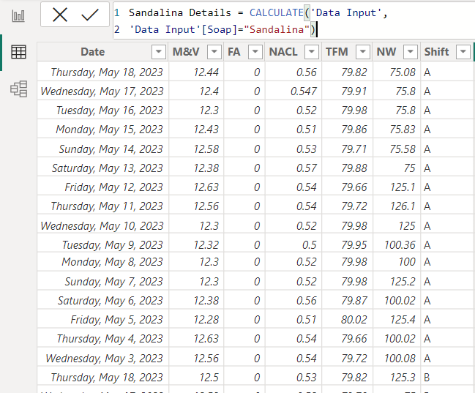
Segregating Soap Data
DAX Code:
Sandalina Details=CALCULATE (‘Data Input’, ‘Data Input’[Soap]= “Sandalina”)

Slide 57
Segregating into Feature Data
Segregation of Soap Entry form into Feature Data
Sandalina
M&V
TFM
NaCl
FA
Net Weight

Slide 58
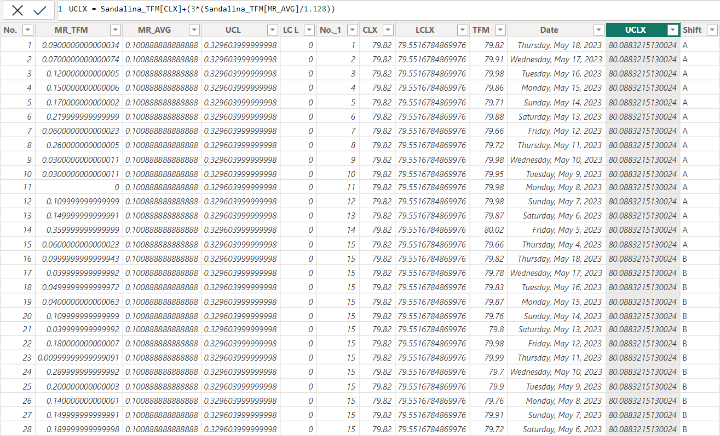
Acquiring Feature Data
DAX Code:
UCLX =
Sandalina TFM[CLX]+
(3*(Sandalina_TFM
[MR_AVG]/1.128))
Generates:
Moving Range chart
Individual Measurement chart

Slide 59
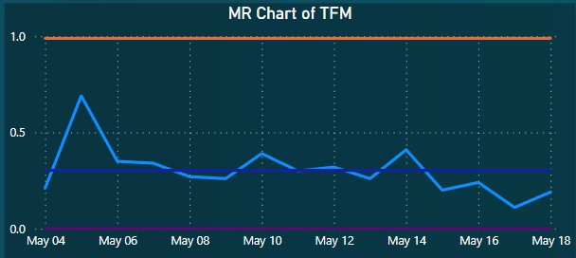
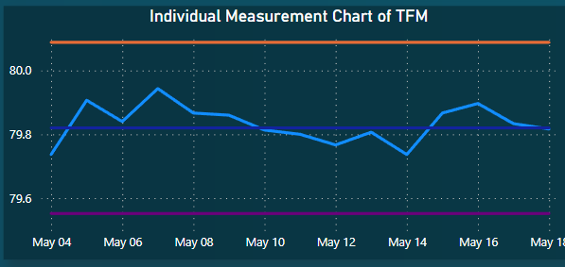
Moving Range Chart
Individual Measurement Chart

Slide 60
Distribution curve
Creating Distribution curve from Feature Data and Quality form Data
Sandalina
TFM
Distribution and Capability Analysis
BSTI_A
BSTI_B

Slide 61
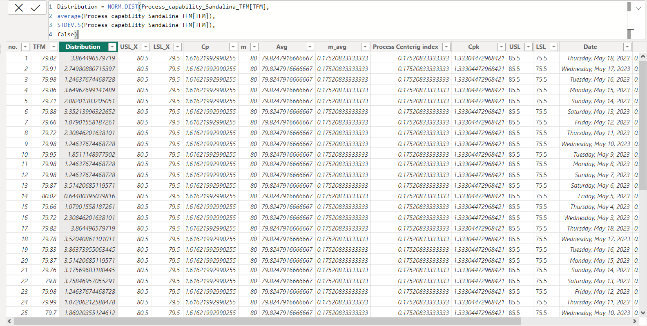
Distribution Curve
Generates:
Distribution curve
Process Capability Index
Process Centering Index
DAX Code:
USLX = SELECTCOLUMNS('Company Target',"USLX",[Sandalina TFM USL])
DAX Code:
Distribution = NORM.DIST(Process_capability_Sandalina_TFM[TFM],
average(Process_capability_Sandalina_TFM[TFM]),
STDEV.S(Process_capability_Sandalina_TFM[TFM]),false)

Slide 62
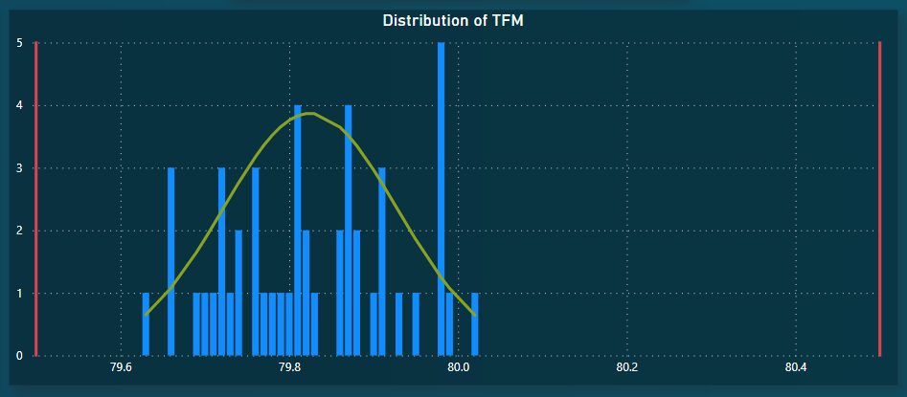
Distribution Curve

Slide 63
CUSUM Chart
Creating Distribution curve from Feature Data and Quality form Data
CUSUM
Sandalina_CUSUM
Sandalina_CUSUM_TFM
Sandalina_CUSUM_NO

Slide 64


CUSUM Chart
DAX Code:
Sandalina_CUSUM = CALCULATETABLE(CUSUM,CUSUM[Soap]="Sandalina")
DAX Code:
Sandalina_CUSUM_TFM=SELECTCOLUMNS(Sandalina_CUSUM,"DATE",[Date],"TFM",[TFM],"Shift",[Shift],"No.",[No.])

Slide 65
CUSUM Chart
DAX Code
Deviation = [TFM]-AVERAGE([TFM])
CUSUM =
CALCULATE(
SUM(Sandalina_CUSUM_TFM[Deviation]),
MAX(Sandalina_CUSUM_TFM_No.[No.])>=Sandalina_CUSUM_TFM_No.[No.]
)

Slide 66

CUSUM Chart

Slide 67
Thanks!
Do you have any questions?

